Slide 1
Credit Card Fraud Detection
GUIDED BY:
DR. GOPIKRISHNAN S
PRESENTED BY:
L BHARADHWAJ REDDY
R. NAGA SAI RAM
B N V R ROHITH
D V L SAI SRUTHI

Slide 2
Abstract . Introduction . Methodology . Problem Statement . Scale-Location . Decision Tree . Artificial Neural Network . Specificity . Conclusion . Reference

Slide 3
ABSTRACT .Credit Card Fraud is increasing considerably with the development of modern technology. .Here we mainly focuscd on credit card fraud transactions in real world. Initially we collected the credit card dataset and performed analysed and then the dataset will be analysis and pre-processed. .After that random forest algorithm is applied for obtaining the accuracy of the dataset. Finally the number of fraud transactions present in the dataset will be identified. .The performance of the techniques is evaluated based on accuracy, sensitivity, specificity and precision. The accuracy of the resultant dataset obtained is about 98%.

Slide 4
INTRODUCTION . Online payments does not require physical card. .Anyone who know the details of card can make fraud transactions. . Currently card holders comes to know only after the fraud transaction is carried out. .No mechanisms are present to track the fraud transactions.

Slide 5
PROBLEM STATEMENT The Credit Card Fraud Detection Problem includes modeling past credit card transactions with the knowledge of the ones that turned out to be a fraud. This model is then used to identify whether a new transaction is fraudulent or not. Our aim here is to detect 100% of the fraudulent transactions while minimizing the incorrect fraud classifications.

Slide 6
METHODOLOGY Credit card fraud is increasing considerably with the development of modern technology and the global superhighways of communication. Credit card fraud costs consumers and the financial company billions of dollars annually, and fraudsters continuously try to find new rules and tactics to commit illegal actions. Thus, fraud detection systems have become essential for banks and financial institution, to minimize their losses. However, there is a lack of published literature on credit card fraud detection techniques, due to the unavailable credit card transactions dataset for researchers. The most commonly techniques used fraud detection methods are Naïve Bayes (NB), Support Vector Machines (SVM), K-Nearest Neighbor algorithms (KNN). These techniques can be used alone or in collaboration using ensemble or meta-learning techniques to build classifiers. But amongst all existing method, ensemble learning methods are identified as popular and common method, not because of its quite straightforward implementation, but also due to its exceptional predictive performance on practical problems. In this paper we trained various data mining techniques used in credit card fraud detection and evaluate each methodology based on certain design criteria.

Slide 7
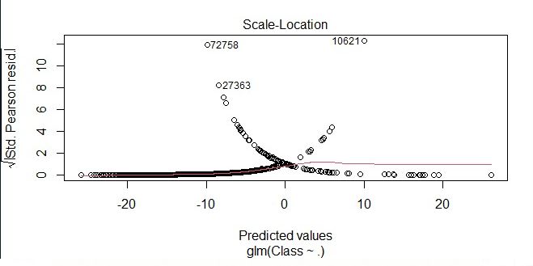
SCALE-LOCATION

Slide 8
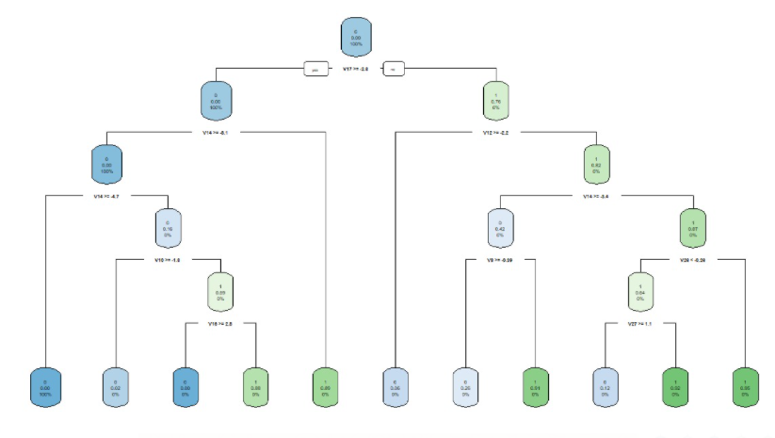
DECISION TREE

Slide 9
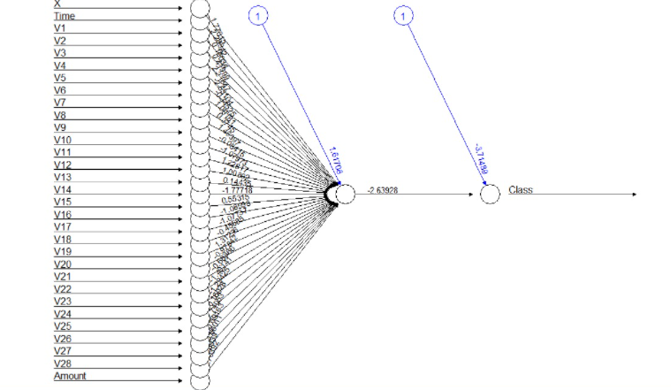
ARTIFICIAL NEURAL NETWORK

Slide 10
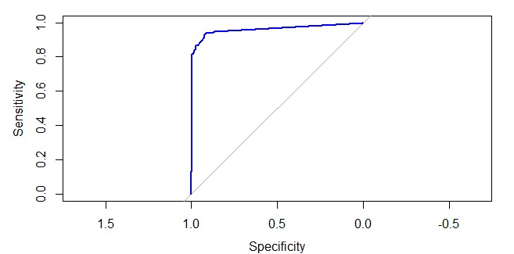
SPECIFICITY

Slide 11
CONCLUSION In this credit card fraud detection project we saw how common people are getting exploited using fraudulent activities. In the previously designed models like Hidden Markov Model which is learning algorithm. It detects the transaction as fraud when a user belongs to low category and perform shigh category payments or vice versa We designed a model that predicts the transaction is fraudulent or not with the help of some ML algorithms like logistic Regression, decision tree, gradient based method and also other methods like mean median mode, KNN. Whenever a fraudulent transaction is carried out the information will be sent to the data analyst.

Slide 12
REFERENCE https://www.google.com/amp/s/spd.group/machine-learning/credit-card-fraud-detection/ https://en.m.wikipedia.org/wiki/Credit_card_fraud https://www.google.com/amp/s/www.chargebackgurus.com/blog/credit-card-fraud-detection%3fhs_amp=true

Slide 13
THANK YOU

